Slide 1
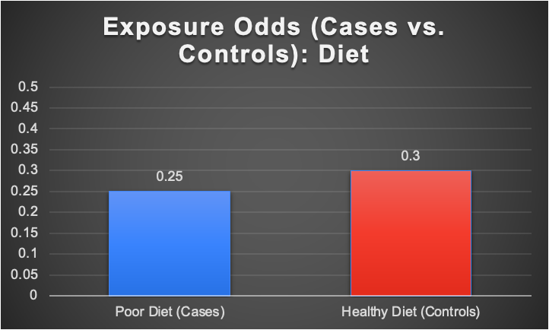
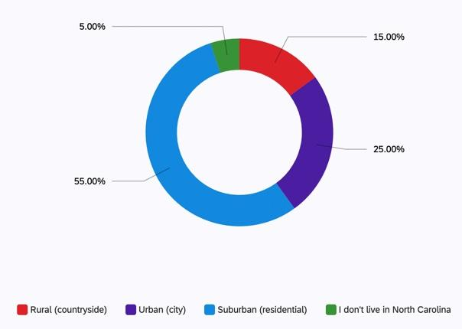
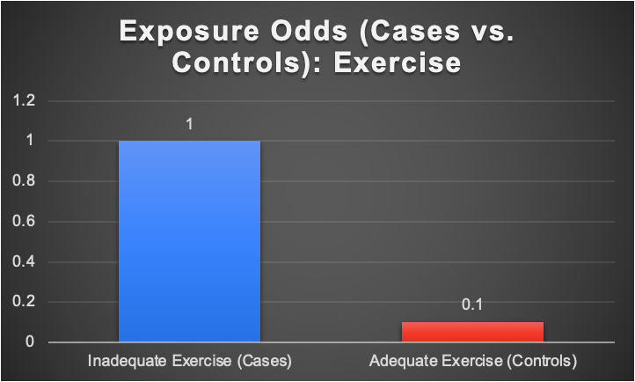
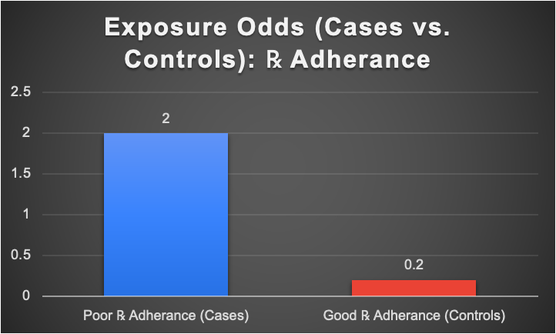
Low Health Literacy & Impact on Kidney Disease and Type 2 Diabetes
Trace Arrick, OTD-S & Christopher Cordon, OTD-S
Duke University School of Medicine, Occupational Therapy Doctorate Division
Introduction
Results
Community partner conducted virtual workshops for people with stage 3 chronic kidney disease (CKD3) and type 2 diabetes (T2DM)
Focal points of workshops include: diet, physical activity, and medication management
Nearly 36% of adults in the U.S. have low health literacy ¹﹐²
We hypothesize that low health literacy negatively impacts managing a healthy diet, physical activity and medication adherence for people with CKD3 and T2DM
Total of 18 survey responses
Key findings include:
Negative association (0.8) between low health literacy and managing a poor diet
Positive association (11) between low health literacy and insufficient physical activity
Positive association (13) between low health literacy and poor medication adherence
Individuals who attended virtual workshops had better management of outcomes despite their level of health literacy, compared to participants who only received tertiary level care
Major themes of qualitative interviews:
Positive feedback on the CKD workshop: praise towards the overall quality of the workshops
Access to technology: Participants had access to WIFI as well as a smart phone and computer. Participants also had the ability to operate Zoom, MyChart, and lifestyle phone applications to manage their diet and physical activity
Self-accountability: resisting certain foods that are unhealthy
Methods
Conclusions
Mixed-method study design:
Case-control survey
Qualitative interview
Sampled people who attended Duke Nephrology Clinic diagnosed with CKD3 and T2DM (n=18)
Excluded were individuals who did not have T2DM and CKD3 diagnosis
Qualitative interviews were administered to workshops participants via phone calls by the co-facilitator of the workshops
Survey administered virtually via Qualtrics
Low health literacy was determined through inconsistent answers in questionnaires, missed appointments and/or medication ³
Analysis using odds ratio calculations to determine the association of low health literacy impact on managing:
A healthy diet e.g. low sodium, low glycemic foods
Physical activity (30 minutes of strength, cardio/aerobic and flexibility exercise)
Medication adherence e.g. missing 2+ doses per week
Age Demographics:
61-80 years old (n=16)
81+ years old (n=2)
Education Demographics:
High school or GED (n=2)
Some college (n=5)
College degree (n=6)
Graduate/Professional degree (n=5)
Low health literacy negatively impacts individuals with CKD3 and T2DM in managing:
Physical activity
Medication adherence
Low health literacy does not affect managing a healthy diet
Limitations:
Study was limited to questions focusing on health literacy levels
The way the data was analyzed led to a majority of unexposed controls on the survey results
Only two qualitative interviews were conducted, so themes are not representative of the intended sample population
Implications for future research:
Practical improvement can examine virtual workshops as the exposure, rather than health literacy, to fully determine its impact on managing each of the three outcomes studied compared to individuals only receiving standard care
References
1. Cutilli, C. C., & Bennett, I. M. (2009). Understanding the health literacy of america. Orthopaedic Nursing, 28(1), 27–32.
2. Mahadevan, A. R., Authors: & Mahadevan, R. (2021, November 10). Health Literacy Fact Sheets. Center for Health Care Strategies.
3. Osborn, C. Y., Weiss, B. D., Davis, T. C., Skripkauskas, S., Rodrigue, C. Bass, P. F., & Wolf, M. S. (2007). Measuring adult literacy in health care: Performance of the newest vital sign. American Journal of Health Behavior, 31(1), 36–46.
Notes:
-Put demographics in the methods
-Expand or give short description on the themes
-clear up bar graph so it only has two bars (odds of exposure in cases vs controls)
-

